Slide 1
IP datagram format
IP protocol version
number
32 bits
total datagram
length (bytes)
header length
(bytes)
head.
len
type of
service
ver
length
for
fragmentation/
reassembly
“type” of data
flgs
fragment
offset
16-bit identifier
max number
remaining hops
(decremented at
each router)
time to
live
upper
layer
Internet
checksum
32 bit source IP address
upper layer protocol
to deliver payload to
32 bit destination IP address
Options (if any)
E.g. timestamp,
record route
taken, pecify
list of routers
to visit.
data
(variable length,
typically a TCP
or UDP segment)
4: Network Layer
4b-<number>

Slide 2

IP Fragmentation & Reassembly
network links have MTU (max.transfer size) - largest possible link-level frame.
  different link types, different MTUs
large IP datagram divided (“fragmented”) within net
  one datagram becomes several datagrams
  “reassembled” only at final destination
  IP header bits used to identify, order related fragments
fragmentation:
in: one large datagram
out: 3 smaller datagrams
reassembly
4: Network Layer
4b-<number>

Slide 3
IP Fragmentation and Reassembly
length
=4000
ID
=x
fragflag
=0
offset
=0
One large datagram becomes
several smaller datagrams
length
=1500
ID
=x
fragflag
=1
offset
=0
length
=1500
ID
=x
fragflag
=1
offset
=1480
length
=1040
ID
=x
fragflag
=0
offset
=2960
4: Network Layer
4b-<number>

Slide 4
ICMP: Internet Control Message Protocol
used by hosts, routers, gateways to communication network-level information
  error reporting: unreachable host, network, port, protocol
  echo request/reply (used by ping)
network-layer “above” IP:
  ICMP msgs carried in IP datagrams
ICMP message: type, code plus first 8 bytes of IP datagram causing error
Type Code description
0 0 echo reply (ping)
3 0 dest. network unreachable
3 1 dest host unreachable
3 2 dest protocol unreachable
3 3 dest port unreachable
3 6 dest network unknown
3 7 dest host unknown
4 0 source quench (congestion
control - not used)
8 0 echo request (ping)
9 0 route advertisement
10 0 router discovery
11 0 TTL expired
12 0 bad IP header
4: Network Layer
4b-<number>

Slide 5
Routing in the Internet
The Global Internet consists of Autonomous Systems (AS) interconnected with each other:
  Stub AS: small corporation
  Multihomed AS: large corporation (no transit)
  Transit AS: provider
Two-level routing:
  Intra-AS: administrator is responsible for choice
  Inter-AS: unique standard
4: Network Layer
4b-<number>

Slide 6
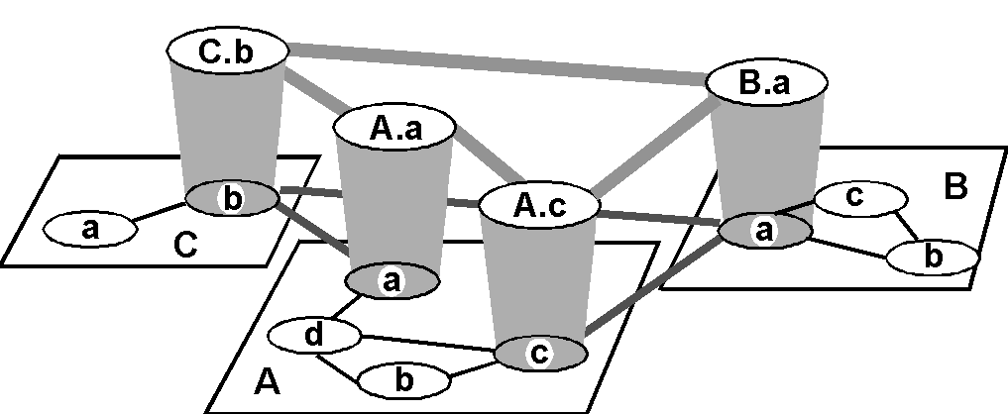
Internet AS Hierarchy
Intra-AS border (exterior gateway) routers
Inter-AS interior (gateway) routers
4: Network Layer
4b-<number>

Slide 7
Intra-AS Routing
Also known as Interior Gateway Protocols (IGP)
Most common IGPs:
  RIP: Routing Information Protocol
  OSPF: Open Shortest Path First
  IGRP: Interior Gateway Routing Protocol (Cisco propr.)
4: Network Layer
4b-<number>

Slide 8
RIP ( Routing Information Protocol)
Distance vector algorithm
Included in BSD-UNIX Distribution in 1982
Distance metric: # of hops (max = 15 hops)
  Can you guess why?
Distance vectors: exchanged every 30 sec via Response Message (also called advertisement)
Each advertisement: route to up to 25 destination nets
4: Network Layer
4b-<number>

Slide 9
RIP (Routing Information Protocol)
z
w
x
y
A
D
B
C
Destination Network Next Router Num. of hops to dest.
w A 2
y B 2
z B 7
x -- 1
…. …. ....
Routing table in D
4: Network Layer
4b-<number>

Slide 10
RIP: Link Failure and Recovery
If no advertisement heard after 180 sec --> neighbor/link declared dead
  routes via neighbor invalidated
  new advertisements sent to neighbors
  neighbors in turn send out new advertisements (if tables changed)
  link failure info quickly propagates to entire net
  poison reverse used to prevent ping-pong loops (infinite distance = 16 hops)
4: Network Layer
4b-<number>

Slide 11
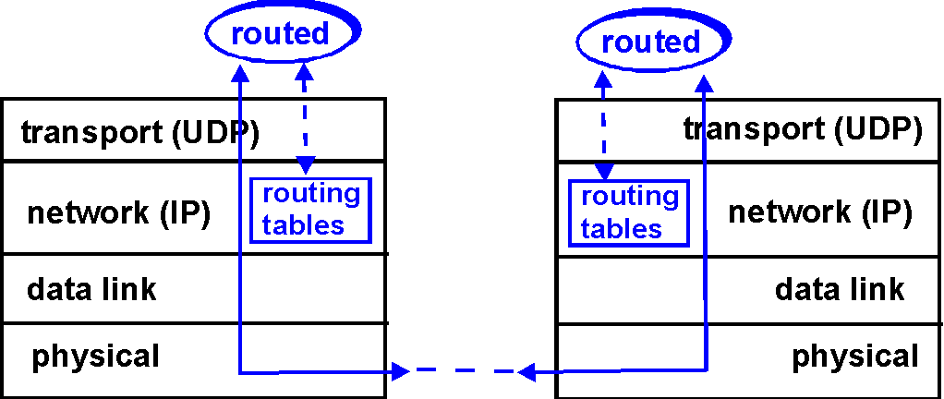
RIP Table processing
RIP routing tables managed by application-level process called route-d (daemon)
advertisements sent in UDP packets, periodically repeated
4: Network Layer
4b-<number>

Slide 12
RIP Table example (continued)
Router: giroflee.eurocom.fr
Destination Gateway Flags Ref Use Interface
-------------------- -------------------- ----- ----- ------ ---------
127.0.0.1 127.0.0.1 UH 0 26492 lo0
192.168.2. 192.168.2.5 U 2 13 fa0
193.55.114. 193.55.114.6 U 3 58503 le0
192.168.3. 192.168.3.5 U 2 25 qaa0
224.0.0.0 193.55.114.6 U 3 0 le0
default 193.55.114.129 UG 0 143454
Three attached class C networks (LANs)
Router only knows routes to attached LANs
Default router used to “go up”
Route multicast address: 224.0.0.0
Loopback interface (for debugging)
4: Network Layer
4b-<number>

Slide 13
OSPF (Open Shortest Path First)
“open”: publicly available
Uses Link State algorithm
  LS packet dissemination
  Topology map at each node
  Route computation using Dijkstra’s algorithm
OSPF advertisement carries one entry per neighbor router
Advertisements disseminated to entire AS (via flooding)
4: Network Layer
4b-<number>

Slide 14
OSPF “advanced” features (not in RIP)
Security: all OSPF messages authenticated (to prevent malicious intrusion); TCP connections used
Multiple same-cost paths allowed (only one path in RIP)
For each link, multiple cost metrics for different TOS (eg, satellite link cost set “low” for best effort; high for real time)
Integrated uni- and multicast support:
  Multicast OSPF (MOSPF) uses same topology data base as OSPF
Hierarchical OSPF in large domains.
4: Network Layer
4b-<number>

Slide 15

Hierarchical OSPF
4: Network Layer
4b-<number>

Slide 16
Hierarchical OSPF
Two-level hierarchy: local area, backbone.
  Link-state advertisements only in area
  each nodes has detailed area topology; only know direction (shortest path) to nets in other areas.
Area border routers: “summarize” distances to nets in own area, advertise to other Area Border routers.
Backbone routers: run OSPF routing limited to backbone.
Boundary routers: connect to other ASs.
4: Network Layer
4b-<number>

Slide 17
IGRP (Interior Gateway Routing Protocol)
CISCO proprietary; successor of RIP (mid 80s)
Distance Vector, like RIP
several cost metrics (delay, bandwidth, reliability, load etc)
uses TCP to exchange routing updates
Loop-free routing via Distributed Updating Alg. (DUAL) based on diffused computation
4: Network Layer
4b-<number>

Slide 18
Inter-AS routing
4: Network Layer
4b-<number>

Slide 19
Internet inter-AS routing: BGP
BGP (Border Gateway Protocol): the de facto standard
Path Vector protocol:
  similar to Distance Vector protocol
  each Border Gateway broadcast to neighbors (peers) entire path (I.e, sequence of ASs) to destination
  E.g., Gateway X may send its path to dest. Z:
Path (X,Z) = X,Y1,Y2,Y3,…,Z
4: Network Layer
4b-<number>

Slide 20
Internet inter-AS routing: BGP
Suppose: gateway X send its path to peer gateway W
W may or may not select path offered by X
  cost, policy (don’t route via competitors AS), loop prevention reasons.
If W selects path advertised by X, then:
Path (W,Z) = w, Path (X,Z)
Note: X can control incoming traffic by controling it route advertisements to peers:
  e.g., don’t want to route traffic to Z -> don’t advertise any routes to Z
4: Network Layer
4b-<number>

Slide 21
Internet inter-AS routing: BGP
BGP messages exchanged using TCP.
BGP messages:
  OPEN: opens TCP connection to peer and authenticates sender
  UPDATE: advertises new path (or withdraws old)
  KEEPALIVE keeps connection alive in absence of UPDATES; also ACKs OPEN request
  NOTIFICATION: reports errors in previous msg; also used to close connection
4: Network Layer
4b-<number>

Slide 22
Why different Intra- and Inter-AS routing ?
Policy:
Inter-AS: admin wants control over how its traffic routed, who routes through its net.
Intra-AS: single admin, so no policy decisions needed
Scale:
hierarchical routing saves table size, reduced update traffic
Performance:
Intra-AS: can focus on performance
Inter-AS: policy may dominate over performance
4: Network Layer
4b-<number>

Slide 23

Router Architecture Overview
Two key router functions:
run routing algorithms/protocol (RIP, OSPF, BGP)
switching datagrams from incoming to outgoing link
4: Network Layer
4b-<number>

Slide 24

Input Port Functions
Physical layer:
bit-level reception
Data link layer:
e.g., Ethernet
see chapter 5
Decentralized switching:
given datagram dest., lookup output port using routing table in input port memory
goal: complete input port processing at ‘line speed’
queuing: if datagrams arrive faster than forwarding rate into switch fabric
4: Network Layer
4b-<number>

Slide 25

Input Port Queuing
Fabric slower that input ports combined -> queueing may occur at input queues
Head-of-the-Line (HOL) blocking: queued datagram at front of queue prevents others in queue from moving forward
queueing delay and loss due to input buffer overflow!
4: Network Layer
4b-<number>

Slide 26

Three types of switching fabrics
4: Network Layer
4b-<number>

Slide 27
Switching Via Memory
First generation routers:
packet copied by system’s (single) CPU
speed limited by memory bandwidth (2 bus crossings per datagram)
Input
Port
Memory
Output
Port
System Bus
Modern routers:
input port processor performs lookup, copy into memory
Cisco Catalyst 8500
4: Network Layer
4b-<number>

Slide 28
Switching Via Bus
datagram from input port memory
to output port memory via a shared bus
bus contention: switching speed limited by bus bandwidth
1 Gbps bus, Cisco 1900: sufficient speed for access and enterprise routers (not regional or backbone)
4: Network Layer
4b-<number>

Slide 29
Switching Via An Interconnection Network
overcome bus bandwidth limitations
Banyan networks, other interconnection nets initially developed to connect processors in multiprocessor
Advanced design: fragmenting datagram into fixed length cells, switch cells through the fabric.
Cisco 12000: switches Gbps through the interconnection network
4: Network Layer
4b-<number>

Slide 30

Output Ports
Buffering required when datagrams arrive from fabric faster than the transmission rate
Scheduling discipline chooses among queued datagrams for transmission
4: Network Layer
4b-<number>

Slide 31

Output port queueing
buffering when arrival rate via switch exceeeds ouput line speed
queueing (delay) and loss due to output port buffer overflow!
4: Network Layer
4b-<number>

Slide 32
IPv6
Initial motivation: 32-bit address space completely allocated by 2008.
Additional motivation:
  header format helps speed processing/forwarding
  header changes to facilitate QoS
  new “anycast” address: route to “best” of several replicated servers
IPv6 datagram format:
  fixed-length 40 byte header
  no fragmentation allowed
4: Network Layer
4b-<number>

Slide 33

IPv6 Header (Cont)
Priority: identify priority among datagrams in flow
Flow Label: identify datagrams in same “flow.”
(concept of“flow” not well defined).
Next header: identify upper layer protocol for data
4: Network Layer
4b-<number>

Slide 34
Other Changes from IPv4
Checksum: removed entirely to reduce processing time at each hop
Options: allowed, but outside of header, indicated by “Next Header” field
ICMPv6: new version of ICMP
  additional message types, e.g. “Packet Too Big”
  multicast group management functions
4: Network Layer
4b-<number>

Slide 35
Transition From IPv4 To IPv6
Not all routers can be upgraded simultaneous
  no “flag days”
  How will the network operatewith mixed IPv4 and IPv6 routers?
Two proposed approaches:
  Dual Stack: some routers with dual stack (v6, v4) can “translate” between formats
  Tunneling: IPv6 carried as payload n IPv4 datagram among IPv4 routers
4: Network Layer
4b-<number>

Slide 36
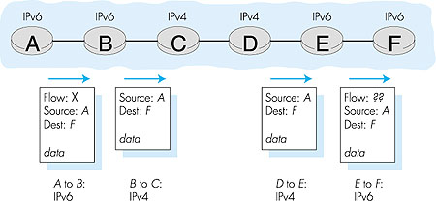
Dual Stack Approach
4: Network Layer
4b-<number>

Slide 37
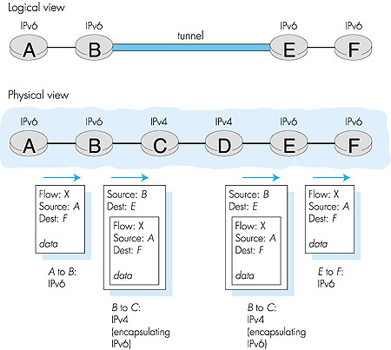
Tunneling
IPv6 inside IPv4 where needed
4: Network Layer
4b-<number>

